Slide 1
SMART2 Project Presentation

Slide 2
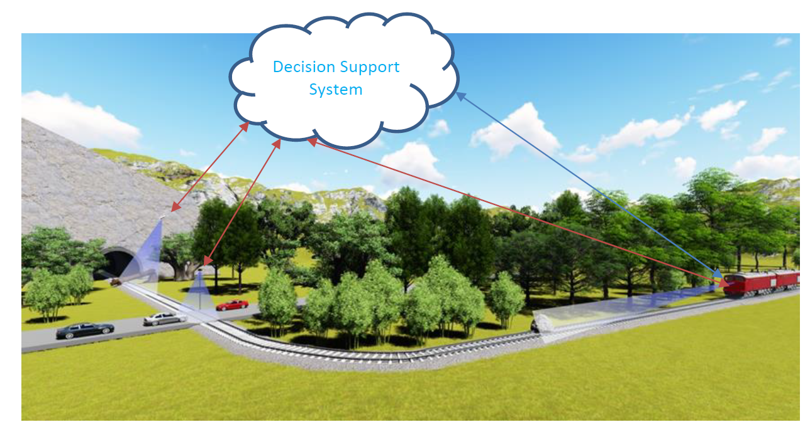
SMART2 Overview
Vision of SMART2 holistic system for OD& TID consisting of on-board, trackside and drone-based OD& TID systems, interfacing with central DSS unit

Slide 3
SMART2 SPECIFIC CHALLENGE
The future of rail freight will be fully automated. For the operation in automation grade (attended and non-attended operation), all activities and responsibilities of today’s train drivers needs to be taken over by several systems.
Among other things, the system must be able to:
Sense the environment to overlook the scene;
Detect potentially dangerous objects on the train’s path;
React accordingly and in the right way.

Slide 4
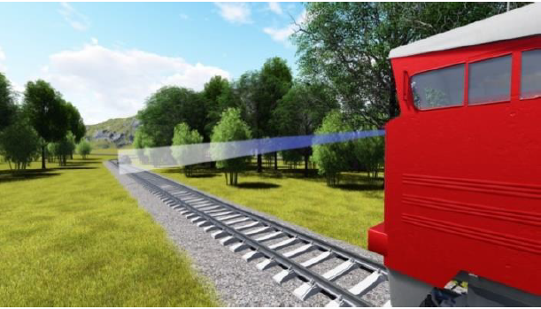
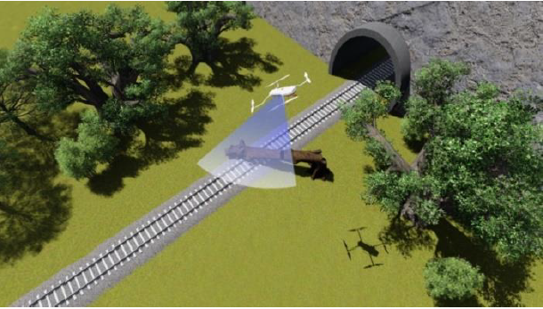
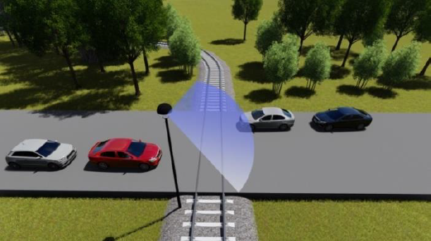
Focus on novel approaches for obstacle detection and track intrusion systems, including trackside, on-board and airborne systems with dedicated interfaces to the GoA 3/4 wayside and on-board systems.

Slide 5
System and components architecture
DRONE
The Phantom 4 RTK UAV, smart mapping and imaging, centimeter-level accuracy, multidirectional obstacle sensing, avoidance system, 1-inch CMOS sensor, 4K video, 20MP, vibration-reduction gimbal.
Processing Hardware
Processing Unit and D-RTK 2 Mobile Station, high-precision GNSS receiver and transmitter, supports all major global satellite navigation systems, provide real-time differential corrections.
RECHARGING STATION
Custom automated battery swapping system, zero invasive modifications to the drone, zero invasive modifications to the battery, warranty not voided, minimal non-operational time, minimal waiting time.

Slide 6
Integration of the airborne data collection and communication system
Drone Phantom 4 RTK
D-RTK 2
Processing Hardware (PH)
Video Data
Telemetry Data
Video Streaming
Desired
Path
Navigation Order

Slide 7
Design of the autonomous UAV control system
Drone Phantom 4 RTK
D-RTK 2
Processing Hardware

Slide 8
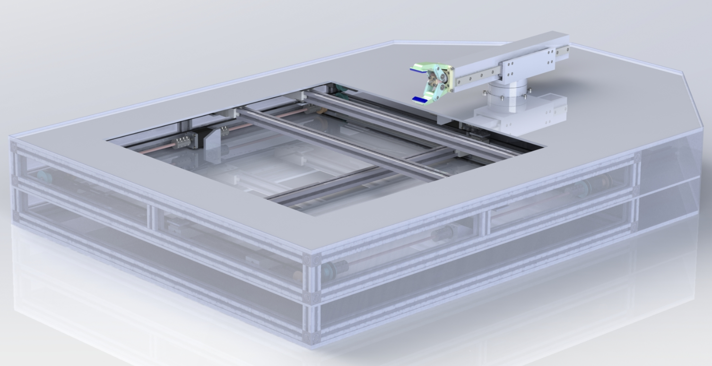
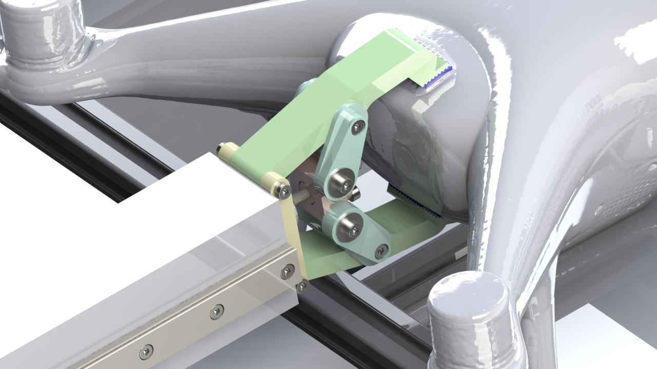
Integration of the automated recharging system
Drone ready for battery removal
Battery removed
Battery charged
Drone ready for take-off
Drone landed
Drone
positioning
Battery
swap started
Battery
inserted into
charger
Battery
reinserted into
drone

Slide 9
Thank you for your attention!

